Slide 1
The Chesapeake Bay: A Socio-Environmental Perspective
Caroline Solomon, Biology
Khadijat Rashid, Economics

Slide 2
1. Where is the Chesapeake Bay?
On the western coast of the US
On the eastern coast of the US
Near the Great Lakes
In Canada

Slide 3
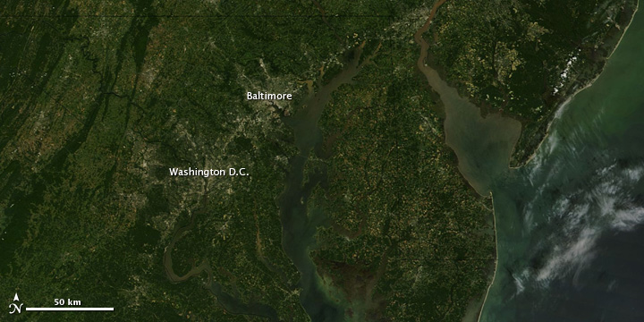
From NASA’s Terra satellite (September 2011)

Slide 4
2. The Chesapeake Bay’s claim to fame is because:
very deep in most areas
very shallow in most areas
It floods frequently
It is the country’s largest estuary

Slide 5
Information about the Chesapeake Bay
4,500 square miles
41 million acres
18 trillion gallons of water
200 miles long, 35 miles long at the largest point
11,700 miles of shoreline
Average of 21 feet deep (shallow)
Largest estuary in the United States

Slide 6
3. The Chesapeake Bay Watershed includes how many states?
1
3
5
6

Slide 7
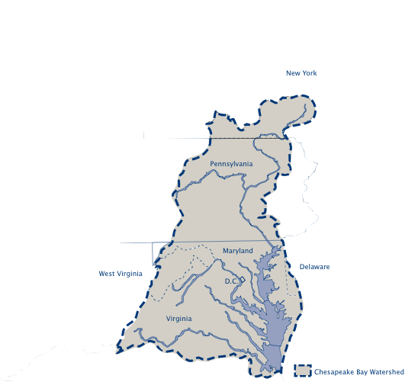
The Chesapeake Bay Watershed

Slide 8
4. The population that lives in the immediate area of the Bay is ~
7 million
17 million
27 million
37 million
Notes:
17 million people live within the Bay waters area, but the total population of the six states and the District in the Bay watershed is 48.5 million

Slide 9
5. Every year, ~ ___ net new people move into the Chesapeake Bay area
75,000
130,000
200,000
1,000,000
Notes:
130,000 yearly move in

Slide 10
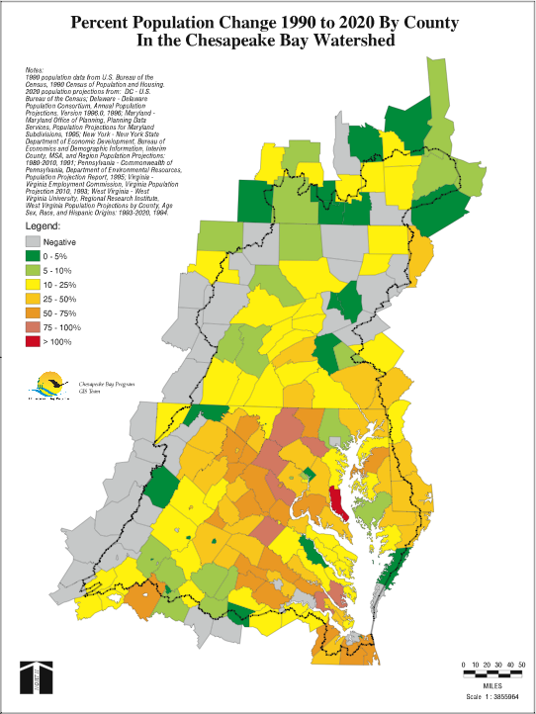
Population in the Chesapeake Bay

Slide 11
6. The health of the Chesapeake Bay was graded as a ______ in 2011?
A
B
C
D
F

Slide 12
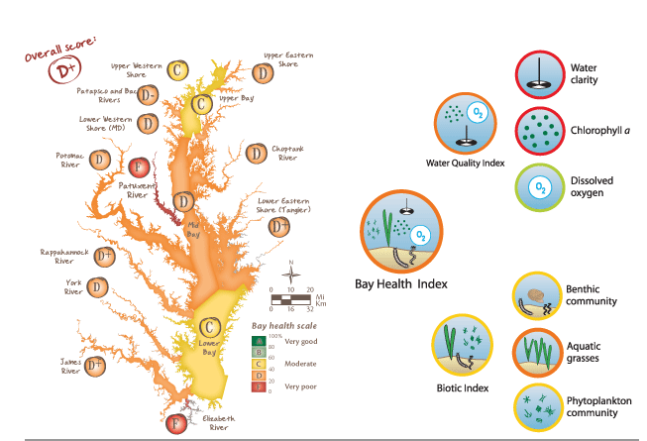
Chesapeake Bay Report Card - 2011

Slide 13
7. The Chesapeake Bay was formed when….
the glaciers retreated during the last Ice Age
a meteorite hit the area
the Appalachian mountains formed and oceanic water entered the valleys
two continental plates diverged (moved away from each other)

Slide 14
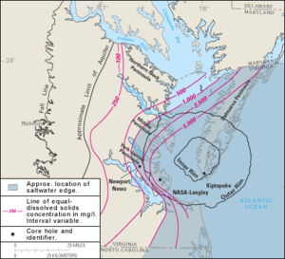

Slide 15
8. The commercial seafood industry in MD and VA alone
Employs approximately 14,000 people and is worth more than $1 billion
Employs approximately 24,000 people and is worth more than $2 billion
Employs approximately 34,000 people and is worth more than $3 billion
Employs approximately 44,000 people and is worth more than $4 billion

Slide 16
Blue crabs, oysters, fish…

Slide 17
9. The total economic value of the Chesapeake Bay has been estimated at
> $10 billion
> $100 billion
> $1 trillion
(note billion = 6 zeros, trillion = 9 zeros)

Slide 18
10. There are _species of plants and animals in the Chesapeake Bay
1,700
2,700
3,700
uncountable
Notes:
3,400 species

Slide 19
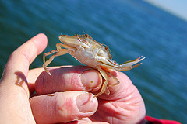
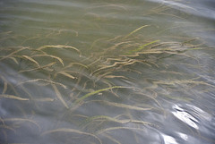
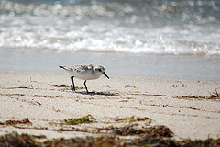

Slide 20
Flora and fauna of the Bay

Slide 21
Structure of course: how we will achieve socio-environmental synthesis!
2 case studies:
Rural case study: Poultry farming on Maryland’s Eastern Shore
Urban case study: Anacostia River in DC

Slide 22
Case study structure
Introduction to case study
What do we need to know about the case study?
Expert/SH #1
Expert/SH #2
Expert/SH #3
Expert/SH #3
What do we now know about the case study?
Synthetic product

